Slide 1
Change Password
SET PASSWORD = 'newpwd'

Slide 2
Data Modeling and SQL

Slide 3
Data Modeling and SQL
Data Model
Graphical description of data elements and connections
Relational model
SQL
Data definition language
Data manipulation language
Data control language

Slide 4
Codd’s Relational Model
Tables
Collection of data describing facts
Relation
Analogous to a table or set
Relational database
Collection of relations
Not relationship!

Slide 5

Entity
Some thing in the environment that we want to keep track of
Entity type vs entity instance
An instance is a particular occurrence of an entity
Represented by a rectangle

Slide 6
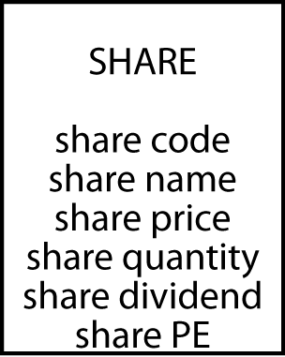
Attributes
An attribute is a discrete data element that describes an entity
Characteristic or property
Attribute names must be unique within a data model
Attribute names must be meaningful

Slide 7
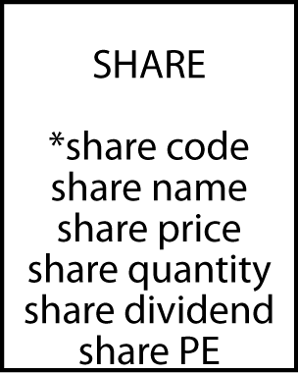
Identifiers
Every instance of an entity must be uniquely identified
An identifier can be an attribute or collection of attributes
An identifier can be created if there is no obvious attribute(s)
A leading asterisk denotes an identifier
Compound identifier

Slide 8
Terms
Database
Collection of related tables
Records
One row in a table for one instance of data
Fields
Columns for fine details of an instance

Slide 9
Rules for creating a table
Each entity becomes a table
The entity name becomes the table name
Each attribute becomes a column
The identifier becomes the primary key
Note: In MySQL having one or more spaces in a table name or attribute name will cause problems. Use the underscore (e.g., share_code) or an upper-case character (e.g., ShareCode).

Slide 10
Exercise
Design a data model for recording details of Olympic cities
See http://en.wikipedia.org/wiki/List_of_Olympic_Games_host_cities

Slide 11
DML and DDL
DDL (Data Definition Language): which deals with database schemas and descriptions, of how the data should reside in the database.
CREATE - to create a database and its objects like (table, index, views, store procedure, function, and triggers)
ALTER - alters the structure of the existing database
DROP - delete objects from the database
…
DML (Data Manipulation): deals with data retrieval and modification
SELECT - retrieve data from a database
INSERT - insert data into a table
UPDATE - updates existing data within a table
DELETE - Delete all records from a database table
…

Slide 12
Use the USE command to choose the database you currently use.
USE xz_abc12345
List all databases available to you.
SHOW databases;
List the current databases.
SELECT databases();

Slide 13
Defining a table with SQL
CREATE TABLE share (
shrcode CHAR(3),
shrfirm VARCHAR(20) NOT NULL,
shrprice DECIMAL(6,2),
shrqty DECIMAL(8),
shrdiv DECIMAL(5,2),
shrpe DECIMAL(2),
PRIMARY KEY(shrcode));

Slide 14
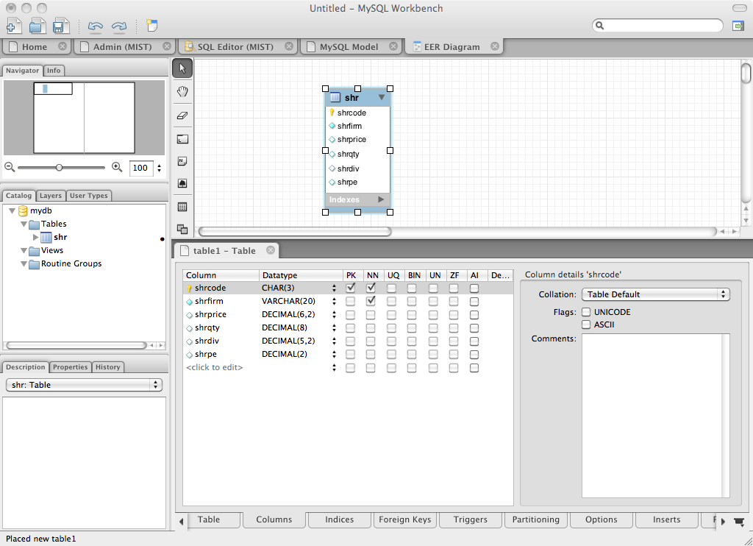
Defining a table with MySQL workbench

Slide 15
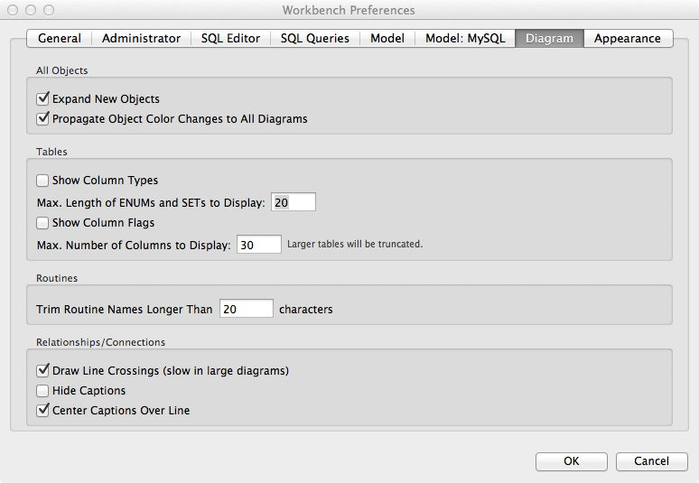
MySQL Workbench preferences
Hide column type
Hide column flag

Slide 16

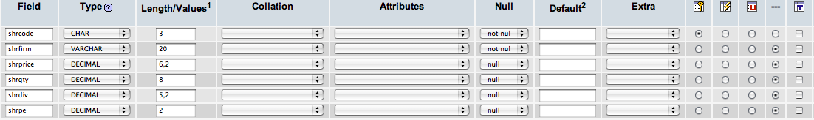
Defining a table with phpMyAdmin

Slide 17
Allowable data types - SQL standard -
Numeric | integer | A 31-bit signed binary value
 | smallint | A 15-bit signed binary value
 | float(p) | A scientific format number of p binary digits precision
 | decimal(p,q) | A packed decimal number of p digits total length; q decimal places to the right of the decimal point may be specified
String | char(n) | A fixed length character string of n characters
 | varchar(n) | A variable length character string up to n characters
 | text | A variable-length character string of up to 65,535 characters
Date/time | date | Date in the form yyyymmdd
 | time | Time in the form hhmmss
 | timestamp | A combination of date and time to the nearest microsecond
https://dev.mysql.com/doc/refman/8.0/en/data-types.html
(partial list)
Notes:
https://dev.mysql.com/doc/refman/8.0/en/data-types.html

Slide 18
Table Structure
List tables in the current database.
SHOW tables;
List all columns in a table.
SHOW COLUMNS FROM tablename;
DESCRIBE tablename;
DESC tablename;

Slide 19
The share table (Text database)
share
shrcode | shrfirm | shrprice | shrqty | shrdiv | shrpe
FC | Freedonia Copper | 27.50 | 10529 | 1.84 | 16
PT | Patagonian Tea | 55.25 | 12635 | 2.50 | 10
AR | Abyssinian Ruby | 31.82 | 22010 | 1.32 | 13
SLG | Sri Lankan Gold | 50.37 | 32868 | 2.68 | 16
ILZ | Indian Lead & Zinc | 37.75 | 6390 | 3.00 | 12
BE | Burmese Elephant | 0.07 | 154713 | 0.01 | 3
BS | Bolivian Sheep | 12.75 | 231678 | 1.78 | 11
NG | Nigerian Geese | 35.00 | 12323 | 1.68 | 10
CS | Canadian Sugar | 52.78 | 4716 | 2.50 | 15
ROF | Royal Ostrich Farms | 33.75 | 1234923 | 3.00 | 6

Slide 20
Single Entity SQL: Data Retrieval
Simple query
Simple criteria, using comparison operators
Compound criteria, using boolean operators
Sort
Limit clause
Computed fields
Built-in-functions
Regular expression
Distinct
Group by
Having
Subquery

Slide 21
Single Entity SQL: DML & DDL
Insert
Update
Delete
Create table
Alter table
Drop table

Slide 22
SELECT Statement
Used for queries on single or multiple tables.
Clauses of the SELECT statement:
Required
SELECT: List the columns (and expressions) that should be returned from the query.
FROM: Indicate the table(s) or view(s) from which data will be obtained.
WHERE: Indicate the conditions under which a row will be included in the result.
GROUP BY: Indicate group(categorization) of results.
HAVING: Indicate the conditions under which a category (group) will be included.
ORDER BY: Sorts the result according to specified criteria.
Notes:
The SELECT statement includes many features that allow you to perform sophisticated queries. You can specify the conditions for rows to be included in the results, and you can choose which columns from these rows should be included. You can either get detailed data, or get aggregate results such as sums and averages. You also have many options in how to sort and format the results.

Slide 23
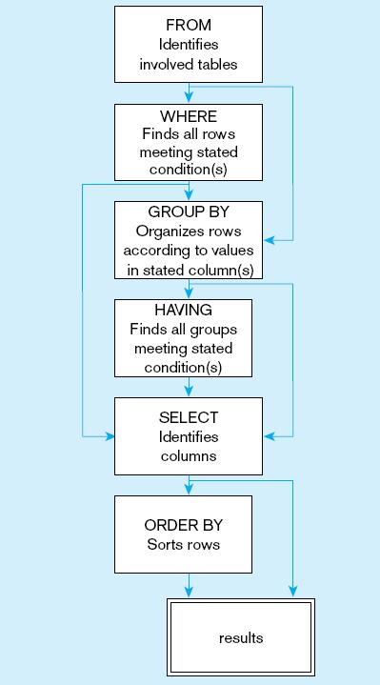
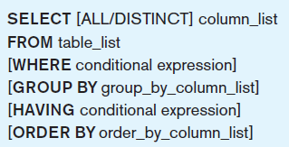
General Syntax of the SELECT statement
SQL statement processing order (adapted from van der Lans, p.100)
Notes:
The SELECT clause specifies which columns to return. The FROM clause specifies from which tables these columns come. The WHERE clause specifies conditions that determine whether a row is returned in the results. GROUP BY and HAVING are used for aggregate queries and ORDER BY determines sorting. Note that queries can also include subqueries, so you may see a SELECT inside another SELECT.

Slide 24
Querying a table
List all data in the share table.
SELECT * FROM share;
(This is a natural language statement)
(This is a SQL statement)
shrcode | shrfirm | shrprice | shrqty | shrdiv | shrpe
FC | Freedonia Copper | 27.50 | 10529 | 1.84 | 16
PT | Patagonian Tea | 55.25 | 12635 | 2.50 | 10
AR | Abyssinian Ruby | 31.82 | 22010 | 1.32 | 13
SLG | Sri Lankan Gold | 50.37 | 32868 | 2.68 | 16
ILZ | Indian Lead & Zinc | 37.75 | 6390 | 3.00 | 12
BE | Burmese Elephant | 0.07 | 154713 | 0.01 | 3
BS | Bolivian Sheep | 12.75 | 231678 | 1.78 | 11
NG | Nigerian Geese | 35.00 | 12323 | 1.68 | 10
CS | Canadian Sugar | 52.78 | 4716 | 2.50 | 15
ROF | Royal Ostrich Farms | 33.75 | 1234923 | 3.00 | 6

Slide 25
Project - Creates a new virtual table
Choosing columns
A vertical slice (select values in specified columns (e.g., shrfirm, shrpe)
share
shrcode | shrfirm | shrprice | shrqty | shrdiv | shrpe
FC | Freedonia Copper | 27.50 | 10529 | 1.84 | 16
PT | Patagonian Tea | 55.25 | 12635 | 2.50 | 10
AR | Abyssinian Ruby | 31.82 | 22010 | 1.32 | 13
SLG | Sri Lankan Gold | 50.37 | 32868 | 2.68 | 16
ILZ | Indian Lead & Zinc | 37.75 | 6390 | 3.00 | 12
BE | Burmese Elephant | 0.07 | 154713 | 0.01 | 3
BS | Bolivian Sheep | 12.75 | 231678 | 1.78 | 11
NG | Nigerian Geese | 35.00 | 12323 | 1.68 | 10
CS | Canadian Sugar | 52.78 | 4716 | 2.50 | 15
ROF | Royal Ostrich Farms | 33.75 | 1234923 | 3.00 | 6

Slide 26
Project
Report a firm’s name and price-earnings ratio.
SELECT shrfirm, shrpe FROM share;
shrfirm | shrpe
Freedonia Copper | 16
Patagonian Tea | 10
Abyssinian Ruby | 13
Sri Lankan Gold | 16
Indian Lead & Zinc | 12
Burmese Elephant | 3
Bolivian Sheep | 11
Nigerian Geese | 10
Canadian Sugar | 15
Royal Ostrich Farms | 6

Slide 27
Restrict - Creates a new virtual table containing some rows of an existing table
Choosing rows (e.g., PE ratio <12)
A horizontal slice
share
shrcode | shrfirm | shrprice | shrqty | shrdiv | shrpe
FC | Freedonia Copper | 27.50 | 10529 | 1.84 | 16
PT | Patagonian Tea | 55.25 | 12635 | 2.50 | 10
AR | Abyssinian Ruby | 31.82 | 22010 | 1.32 | 13
SLG | Sri Lankan Gold | 50.37 | 32868 | 2.68 | 16
ILZ | Indian Lead & Zinc | 37.75 | 6390 | 3.00 | 12
BE | Burmese Elephant | 0.07 | 154713 | 0.01 | 3
BS | Bolivian Sheep | 12.75 | 231678 | 1.78 | 11
NG | Nigerian Geese | 35.00 | 12323 | 1.68 | 10
CS | Canadian Sugar | 52.78 | 4716 | 2.50 | 15
ROF | Royal Ostrich Farms | 33.75 | 1234923 | 3.00 | 6

Slide 28
Restrict - Creates a new virtual table that contains some rows of an existing table
Display records for all firms whose price-earnings ratio is less than 12. SELECT * FROM share WHERE shrpe < 12;
shrcode | shrfirm | shrprice | shrqty | shrdiv | shrpe
PT | Patagonian Tea | 55.25 | 12635 | 2.50 | 10
BE | Burmese Elephant | 0.07 | 154713 | 0.01 | 3
BS | Bolivian Sheep | 12.75 | 231678 | 1.78 | 11
NG | Nigerian Geese | 35.00 | 12323 | 1.68 | 10
ROF | Royal Ostrich Farms | 33.75 | 1234923 | 3.00 | 6

Slide 29
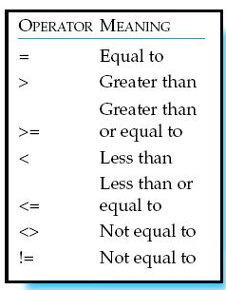
Using Comparison Operators

Slide 30
Project and restrict combo
Choosing rows and columns
List the name, price, quantity, and dividend of each firm where the number of shares held is at least 100,000.
SELECT shrfirm, shrprice, shrqty, shrdiv
FROM share WHERE shrqty >= 100000;
shrfirm | shrprice | shrqty | shrdiv
Burmese Elephant | 0.07 | 154713 | 0.01
Bolivian Sheep | 12.75 | 231678 | 1.78
Royal Ostrich Farms | 33.75 | 1234923 | 3.00

Slide 31
Primary key retrieval
A query using the primary key returns at most one row
(Purpose/power of primary key is guarantee of unique row selection)
Display the firm whose code is AR.
SELECT * FROM share WHERE shrcode = 'AR';
shrcode | shrfirm | shrprice | shrqty | shrdiv | shrpe
AR | Abyssinian Ruby | 31.82 | 22010 | 1.32 | 13

Slide 32
Primary key retrieval
A query that does not use the primary key can return more than one row
Report firms with a dividend of 2.50.
SELECT * FROM share WHERE shrdiv = 2.5;
shrcode | shrfirm | shrprice | shrqty | shrdiv | shrpe
PT | Patagonian Tea | 55.25 | 12635 | 2.50 | 10
CS | Canadian Sugar | 52.78 | 4716 | 2.50 | 15

Slide 33
Exercise
Report the name and price of those shares where the share price is greater than 10

Slide 34
Compound Criteria: Using Boolean Operators
AND, OR, and NOT operators for customizing conditions in WHERE clause.
AND joins two or more conditions and returns results only when all conditions are true.
OR joins two or more conditions and returns results when any conditions are true.
NOT Negates an expression.

Slide 35
IN
Used with a list of values
Report data on firms with codes of FC, AR, or SLG.
SELECT * FROM share WHERE shrcode IN ('FC','AR','SLG');
or
SELECT * FROM share WHERE shrcode = 'FC' OR
shrcode = 'AR' OR shrcode = 'SLG';
shrcode | shrfirm | shrprice | shrqty | shrdiv | shrpe
FC | Freedonia Copper | 27.50 | 10529 | 1.84 | 16
AR | Abyssinian Ruby | 31.82 | 22010 | 1.32 | 13
SLG | Sri Lankan Gold | 50.37 | 32868 | 2.68 | 16

Slide 36
NOT IN
Not in a list of values Report all firms other than those with the code CS or PT.
SELECT * FROM share WHERE shrcode NOT IN ('CS', 'PT’);
is equivalent to
SELECT * FROM share WHERE shrcode <> 'CS' AND shrcode <> 'PT';
shrcode | shrfirm | shrprice | shrqty | shrdiv | shrpe
AR | Abyssinian Ruby | 31.82 | 22010 | 1.32 | 13
SLG | Sri Lankan Gold | 50.37 | 32868 | 2.68 | 16
ILZ | Indian Lead & Zinc | 37.75 | 6390 | 3.00 | 12
BE | Burmese Elephant | 0.07 | 154713 | 0.01 | 3
BS | Bolivian Sheep | 12.75 | 231678 | 1.78 | 11
NG | Nigerian Geese | 35.00 | 12323 | 1.68 | 10
ROF | Royal Ostrich Farms | 33.75 | 1234923 | 3.00 | 6

Slide 37
Ordering output
Ordering columns
Columns are reported in the order specified in the SQL command
Ordering rows
Rows are ordered using the ORDER BY clause

Slide 38
Ordering columns
SELECT shrcode, shrfirm FROM share WHERE shrpe = 10;
SELECT shrfirm, shrcode FROM share WHERE shrpe = 10;
shrcode | shrfirm
PT | Patagonian Tea
NG | Nigerian Geese
shrfirm | shrcode
Patagonian Tea | PT
Nigerian Geese | NG

Slide 39
Ordering rows
List all firms where PE is at least 12. Order the report in descending PE. Where PE ratios are identical, list firms in alphabetical order.
SELECT * FROM share WHERE shrpe >= 12
ORDER BY shrpe DESC, shrfirm;
shrcode | shrfirm | shrprice | shrqty | shrdiv | shrpe
FC | Freedonia Copper | 27.50 | 10529 | 1.84 | 16
SLG | Sri Lankan Gold | 50.37 | 32868 | 2.68 | 16
CS | Canadian Sugar | 52.78 | 4716 | 2.50 | 15
AR | Abyssinian Ruby | 31.82 | 22010 | 1.32 | 13
ILZ | Indian Lead & Zinc | 37.75 | 6390 | 3.00 | 12

Slide 40
Practice Exercise 1: Using the Chapter3 database Entity & Table named STUDENT
Attributes of the entity/columns of the table
Write queries to:
List the table of students
List first name, middle initial, last name, & state for all students
List last name, first name, & middle initial for all students
List all information for students from Georgia (‘GA’)
List all information for students not from Georgia
List the last and first names of all students from South Carolina (‘SC’), Alabama (‘AL’), or Georgia (‘GA’)
STUDENT
* studentID
f_name
middle_init
l_name
city
state
zip

Slide 41
Practice Exercise 1.1
Use the ClassicModels database (refer to the data model present on the text website)
List out the entire contents of the Customers table
List out the customer name for customers from USA or France
List out the customer name for those customers from USA or France that have a credit limit greater than 75000
List out names for products where the quantity of product in stock is more than 5000 units
List out the names of products and the MSRP and buy price if the product is a type of classic car. Order the results in descending order of the MSRP.

Slide 42
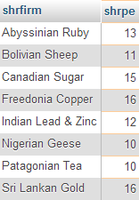
BETWEEN – Specifying a range (range includes the values listed)
List the firm name and share PE for those firms whose PE is at least 10 and as much as 20.
SELECT shrfirm, shrpe
FROM share
WHERE shrpe BETWEEN 10 AND 20;

Slide 43
Practice Exercise 4 Entity & Table named ITEM
Write queries to:
List the item name and category for all items whose price is greater than or equal to $10 and less than or equal to $50. List the items with the most expensive one first.
List the item category, item ID, and item name of all items that cost at least $5 and up to $20. Order the items in alphabetical order by item category. List items in the same category in order by price, with the lowest price first.
List all items that fall in the $20 to $40 price range in ascending order by item name.
Attributes of the entity/columns of the table
ITEM
* itemID
item_name
item_category
item_price

Slide 44
Quick Recap
Single-Table SQL Query: Data Retrieval
Simple query
Simple criteria, using comparison operators
Compound criteria, using Boolean operators
Sort
Computed fields
Built-in-functions
Regular expression
Distinct
Group by
Having
Subquery
Limit clause

Slide 45
Calculating: Computed Field
Display firm name, price, quantity, and firm yield.
SELECT shrfirm, shrprice, shrqty,
shrdiv/shrprice*100 as YIELD FROM share;
shrfirm | shrprice | shrqty | yield
Freedonia Copper | 27.50 | 10,529 | 6.69
Patagonian Tea | 55.25 | 12,635 | 4.52
Abyssinian Ruby | 31.82 | 22,010 | 4.15
Sri Lankan Gold | 50.37 | 32,868 | 5.32
Indian Lead & Zinc | 37.75 | 6,390 | 7.95
Burmese Elephant | 0.07 | 154,713 | 14.29
Bolivian Sheep | 12.75 | 231,678 | 13.96
Nigerian Geese | 35.00 | 12,323 | 4.80
Canadian Sugar | 52.78 | 4,716 | 4.74
Royal Ostrich Farms | 33.75 | 1,234,923 | 8.89

Slide 46
Built-in functions
COUNT, AVG, SUM, MIN, and MAX
Find the average dividend.
SELECT AVG(shrdiv) AS avgdiv FROM share;
What is the average yield for the portfolio?
SELECT AVG(shrdiv/shrprice*100) AS avgyield FROM share;
avgdiv
2.03
avgyield
7.53

Slide 47
Built-in function COUNT
You can use the COUNT built-in function to determine the number of rows or non-Null values in a Result Set.
Use COUNT(*) to find out the number of rows in the entire set.
Use COUNT (column name) to find out the number of rows with non-null values for that column.

Slide 48
Practice Exercise 2 Entity & Table named ITEM
Write queries to:
List all items
List all items whose price is greater than $25
List the item name for items whose price < $100
List the average price of items whose category is ‘toy’
List the item name and price for items whose price more than the average price of all items
List all items in descending order by price
List the number of items
Attributes of the entity/columns of the table
ITEM
* itemID
item_name
item_category
item_price

Slide 49
Practice Exercise 1.2
Use the ClassicModels database (refer to the data model present on the text website)
How many customers are present in the database?
What is the average payment amount made?
List out the names of customers whose credit limit is greater than the average credit limit.
List out the name of the customer who has the greatest credit limit.
List out the total value of all orders placed.

Slide 50
Regular expression
A concise and flexible method for string searching
Commands are handled by a regular expression processor
Supported by many programming languages

Slide 51
Regular expression
Search for a string
List all firms containing ‘Ruby’ in their name.
SELECT shrfirm FROM share
WHERE shrfirm REGEXP 'Ruby';
shrfirm
Abyssinian Ruby

Slide 52
Regular expression
Search for alternative strings
[a|b] finds 'a' or 'b'
| is the alternation symbol
List the firms containing gold or zinc in their name.
SELECT * FROM share
WHERE shrfirm
REGEXP 'gold|zinc|Gold|Zinc';

Slide 53
Regular expression
Search for a beginning string
^ means at the start of the string
List the firms whose name begins with Sri.
SELECT * FROM share
WHERE shrfirm REGEXP '^Sri';

Slide 54
Regular expression
Search for an ending string
$ means at the end of the string
List the firms whose name ends in Geese.
SELECT shrfirm
FROM share
WHERE shrfirm REGEXP 'Geese$';

Slide 55
Using Wildcards
Wildcard | Description
* | All columns
% | Any collection of characters
_ | Exactly one character
Note: the LIKE operator allows you to compare strings using wildcards.
For example, the % wildcard in ‘%Desk’ indicates that all strings that have any number of characters preceding the word “Desk” will be allowed.

Slide 56
Wildcards
SELECT * FROM share WHERE shrfirm LIKE '%gold%’;
SELECT * FROM share WHERE shrfirm LIKE 'gold%’;
SELECT * FROM share WHERE shrfirm LIKE '%gold’;
SELECT * FROM share WHERE shrcode LIKE '__G';

Slide 57
Exercise
List names of shares whose name contains sheep or geese

Slide 58
DISTINCT
Eliminating duplicate rows
Find the number of different PE ratios.
SELECT COUNT(DISTINCT shrpe) AS 'Different PEs' FROM share;
Different PEs
8
DISTINCT column-name is not implemented by all relational systems

Slide 59
DISTINCT
Eliminating duplicate rows
Report the different values of the PE ratio.
SELECT DISTINCT shrpe FROM share;
shrpe
3
6
10
11
12
13
15
16

Slide 60
Practice Exercise 3 Entity & Table named STUDENT
Attributes of the entity/columns of the table
Write queries to:
List the first name, middle initial, and last name for students whose last name begins with an ‘S’
List the students who have the letter ‘A’ or ‘a’ somewhere in their first name
Display the number of students from Georgia
List each city for students in the table – do not repeat city names
STUDENT
* studentID
f_name
middle_init
l_name
city
state
zip

Slide 61
Practice Exercise 1.3
Use the ClassicModels database (refer to the data model present on the text website)
List out all the countries where the organization has customers
List out the different statuses that orders can have
List out the names of customers if they have ‘Gift’ or ‘gift’ in their names.

Slide 62
GROUP BY
Group records by columns specified.
Apply aggregate functions to each group and display the results.

Slide 63
GROUP BY
SELECT COUNT(shrpe), shrpe FROM share
GROUP BY shrpe
ORDER BY COUNT(shrpe) DESC;
SELECT AVG(shrprice), shrpe FROM share
GROUP BY shrpe;
SELECT AVG(shrprice), COUNT(shrprice), MAX(shrprice), MIN(shrprice),shrpe FROM share GROUP BY shrpe;

Slide 64
Having
Only be used following a GROUP BY
Act as a secondary WHERE clause
Return only those groups that meet a specified condition
Can use aggregate function in the Having clause

Slide 65
Having
SELECT shrpe, COUNT(shrpe) FROM share
GROUP BY shrpe
HAVING COUNT(shrpe) > 1;
Like a WHERE clause, but HAVING operates on groups (categories), not on individual rows. Here, only those groups with total numbers greater than 1 will be included in final result.

Slide 66
Subqueries
A query within a query
Report all firms with a PE ratio greater than the average for the portfolio.
SELECT shrfirm, shrpe FROM share WHERE shrpe >(SELECT AVG(shrpe)FROM share);
shrfirm | shrpe
Freedonia Copper | 16
Abyssinian Ruby | 13
Sri Lankan Gold | 16
Indian Lead & Zinc | 12
Canadian Sugar | 15

Slide 67
Practice Exercise 2 Entity & Table named ITEM
Write queries to:
List all items
List all items whose price is greater than $25
List the item name for items whose price < $100
List the average price of items whose category is ‘toy’
List the item name and price for items whose price more than the average price of all items
List all items in descending order by price
List the number of items
Attributes of the entity/columns of the table
ITEM
* itemID
item_name
item_category
item_price

Slide 68
Practice Exercise 1.2
Use the ClassicModels database (refer to the data model present on the text website)
How many customers are present in the database?
What is the average payment amount made?
List out the names of customers whose credit limit is greater than the average credit limit.
List out the name of the customer who has the greatest credit limit.
List out the total value of all orders placed.
Notes:
https://sqlzoo.net/wiki/SELECT_from_Nobel_Tutorial
https://www.sqlcourse.com/advanced-course/group-by-clause/

Slide 69
DML & DDL
Introduced
Entity
Attribute
Identifier
SQL
CREATE
INSERT
SELECT
DELETE
UPDATE

Slide 70
Inserting rows with SQL
INSERT INTO share
(shrcode,shrfirm,shrprice,shrqty,shrdiv,shrpe)
VALUES ('FC','Freedonia Copper',27.5,10529,1.84,16);
OR
INSERT INTO share
VALUES ('FC','Freedonia Copper',27.5,10529,1.84,16);

Slide 71
Importing from a text file
LOAD DATA LOCAL INFILE
'/Users/rtw/desktop/share.txt' INTO TABLE SHARE
FIELDS TERMINATED BY ','
ENCLOSED BY "'"
LINES TERMINATED BY '\r’
Content of share.txt
FC,'Freedonia Copper',27.5,10529,1.84,16
PT,'Patagonian Tea',55.25,12635,2.5,10
AR,'Abyssinian Ruby',31.82,22010,1.32,13
SLG,'Sri Lankan Gold',50.37,32868,2.68,16
ILZ,'Indian Lead & Zinc',37.75,6390,3,12
BE,'Burmese Elephant',0.07,154713,0.01,3
BS,'Bolivian Sheep',12.75,231678,1.78,11
NG,'Nigerian Geese',35,12323,1.68,10
CS,'Canadian Sugar',52.78,4716,2.5,15
ROF,'Royal Ostrich Farms',33.75,1234923,3,6

Slide 72
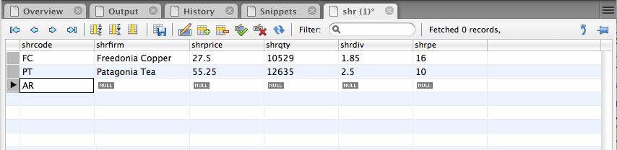
Inserting rows with MySQL Workbench

Slide 73
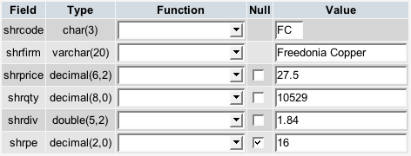
Inserting rows with phpMyAdmin

Slide 74
Exercise
Use MySQL Workbench to design your data model for recording details of Olympic cities
Create a table and add rows for the first three Olympics

Slide 75
DELETE - deleting rows
Erase the data for Burmese Elephant. All the shares have been sold.
DELETE FROM share
WHERE shrfirm = 'Burmese Elephant';

Slide 76
UPDATE - changing rows
Change the share price of FC to 31.50.
UPDATE share
SET shrprice = 31.50
WHERE shrcode = 'FC';

Slide 77
UPDATE - changing rows
Increase the total number of shares for Nigerian Geese by 10% because of the recent bonus issue.
UPDATE share
SET shrqty = shrqty*1.1
WHERE shrfirm = 'Nigerian Geese';

Slide 78
Changing Tables
ALTER TABLE statement allows you
Add new column
Change column specifications
Add table constraints
Drop table constraints

Slide 79

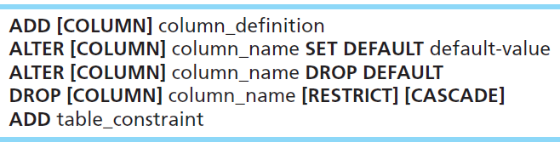

Changing Tables
ALTER TABLE statement allows you to change column specifications:
Table Actions:
Example (adding a new column with a default value):
Notes:
The ALTER command will be done after tables have already been created. For example, if you have an existing database, even one with actual data in it, you can modify tables by adding or changing columns, removing columns, adding constraints, etc. If data in the tables violate the constraints, you will be prevented from setting these constraints until after changing the data.
So, whereas CREATE TABLE is mostly a process that takes place during implementation, ALTER TABLE often takes place during maintenance.

Slide 80
Removing Tables
DROP TABLE statement allows you to remove tables from your schema:
DROP TABLE share;
Notes:
Tables will not be dropped if there are other tables that depend on them. This means that if any table has a foreign key to the table being dropped, the drop will fail. Therefore, it makes a difference which order you drop the tables in.

Slide 81
Quotes
Three kinds of quotes
Single ' (must be straight not curly)
Double " (must be straight not curly)
Back ` ( left of 1 key)
In MySQL, the first two are equivalent and can be used interchangeably
SELECT `person first` FROM person WHERE `person last` = "O'Hara";

Slide 82
Constraints
List all constraints in your table:
SELECT CONSTRAINT_NAME, CONSTRAINT_TYPE
FROM INFORMATION_SCHEMA.TABLE_CONSTRAINTS
WHERE TABLE_NAME = 'Ship’ AND
TABLE_SCHEMA = 'lx_try’;
Add/Delete the primary key:
ALTER TABLE Ship DROP PRIMARY KEY;
ALTER TABLE Ship ADD PRIMARY KEY (shpCode);

Slide 83
Summary
Introduced
Entity
Attribute
Identifier
SQL
CREATE
INSERT
SELECT
DELETE
UPDATE

Slide 84
Summary: Single Entity SQL Data Retrieval
Simple query
Simple criteria, using comparison operators
Compound criteria, using boolean operators
Sort
Limit clause
Computed fields
Built-in-functions
Regular expression
Distinct
Group by
Having
Subquery

